Slide 1
LightGBM and CatBoost Methods
LightGBM and CatBoost are powerful gradient boosting algorithms for fast and accurate predictive modeling.

Slide 2
Contents
01
02
What is LightGBM?
Level-Wise vs Leaf-Wise Split
03
04
How Continuous Variables Are Treated
GBM vs LightGBM
05
06
How LightGBM Works
Key LightGBM Parameters
07
08
What is CatBoost?
How CatBoost Works
09
10
Key CatBoost Parameters
LightGBM vs CatBoost

Slide 3
LightGBM and CatBoost Methods
LightGBM and CatBoost are modern gradient boosting frameworks built to solve speed, scalability, and preprocessing issues in machine learning systems.
LightGBM
Microsoft's high-speed framework for large tabular datasets
CatBoost
Yandex's solution for automatic categorical feature handling

Slide 4
Why Not Just Traditional GBM?
Slow Training
Traditional GBM struggles with large datasets, requiring excessive computation time
High Memory Usage
Memory consumption becomes prohibitive as data scales
Manual Categorical
Variables Handling
Requires extensive preprocessing for categorical features
These limitations drove the development of optimized frameworks like LightGBM and CatBoost.

Slide 5
What is LightGBM?
Light Gradient Boosting Machine
Developed by Microsoft, LightGBM is designed for high speed and low memory consumption. It works best for large tabular datasets where traditional GBM methods become slow and require significant processing time.
Key Advantage
Dramatically faster training with minimal accuracy trade-off

Slide 6
Core Idea of LightGBM
1. Leaf-Wise Tree Growth
Instead of growing entire levels, grows only the most important leaf
2. Faster Learning
Achieves better accuracy with fewer iterations
3. Overfitting Risk
Requires careful depth control to prevent overfitting
LightGBM builds decision trees using a leaf-wise growth strategy, splitting the leaf
with the highest loss reduction to improve accuracy and training speed on large datasets.

Slide 7
Level-Wise vs Leaf-Wise Split
Level-Wise (GBM) | Leaf-Wise (LightGBM)
Grows trees level-wise by splitting all nodes at each level. | splits the leaf that gives the maximum reduction in loss (highest information gain).
Creates balanced trees | Creates unbalanced trees
Slower but more stable | Faster convergence

Slide 8
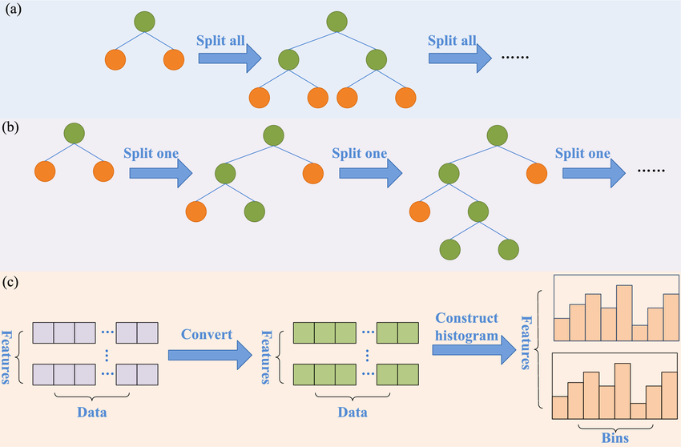
Visual Comparison
(a) Level-wise (GBM): All nodes at the same depth are split together, creating balanced trees. It is stable but slower because even less important nodes are expanded.
(b) Leaf-wise (LightGBM): Only the leaf with highest reduction in loss is split each time, growing the tree vertically. This learns faster and can be more accurate, but may overfit if not controlled.
(c) Histogram Binning (LightGBM): Continuous values are grouped into bins instead of checking every exact value, which greatly reduces memory usage and speeds up training with minimal accuracy loss.

Slide 9
How Continuous Variables Are Treated
1. Histogram Binning
Converts continuous values into discrete bins
2. Example
Age → 18–25, 26–35, 36–50
3. Result
Reduced memory and faster training
Continuous features are converted into discrete bins, which greatly reduces computation during split finding.
This significantly speeds up training and reduces memory usage, making LightGBM efficient for large datasets.
In GBM method:
Split points are searched by evaluating many possible threshold values of continuous features, which increases
computational cost and training time.

Slide 10
How LightGBM Works
01 – Start with Base Prediction
Initialize model with mean (regression) or log-odds (classification).
02 – Convert Continuous Features into Bins (Histogram Binning)
Discretize numeric features into fixed bins to reduce computation and memory.
03 – Calculate Residual Errors
Compute gradients (errors) between actual and predicted values.
04 – Find Best Split Using Histogram Statistics
Evaluate split gains using aggregated gradient statistics in each bin.
05 – Split Leaf with Maximum Gain (Leaf-Wise Growth)
Expand the leaf that gives the highest reduction in loss.
06 – Update Predictions and Repeat
Add tree output to predictions and iterate for the next tree.

Slide 11
Key LightGBM Parameters
num_leaves
Maximum number of terminal
leaves in one tree
max_depth
max_depth is an optional parameter that limits how deep the tree can grow
learning_rate
Learning rate controls how much each new tree contributes to updating the model’s predictions.
feature_fraction
Fraction of features for each iteration
n_estimators
specifies the total number of boosting trees built sequentially in the model.

Slide 12
LightGBM Python Implementation
from lightgbm import LGBMClassifier
lgbm = LGBMClassifier(
n_estimators=100,
learning_rate=0.1,
random_state=42
)
lgbm.fit(X_train, y_train)
predictions = lgbm.predict(X_test)

Slide 13
What is CatBoost?
Categorical Boosting
Developed by Yandex for automatic categorical feature handling.
Introduces ordered boosting to reduce prediction shift and overfitting compared to traditional GBM.
Minimal Preprocessing
It converts categorical variables into numerical form internally eliminating the need for manual encoding.

Slide 14
Ordered Boosting
How Ordered Boosting Works in CatBoost
CatBoost randomly shuffles the dataset and creates a permutation of observations.
This shuffled order is treated as a pseudo-sequence during training.
For any observation i, the model is trained using only observations appearing before i in that permutation.
Thus, “past” simply means earlier in the random order, not earlier in time.
What Happens in Traditional GBM
In GBM, all observations are used simultaneously to compute residuals and update trees.
This means an observation’s own target value indirectly influences its prediction, which can cause prediction shift (target leakage).

Slide 15
How CatBoost Works
Detect categorical features automatically
Apply ordered boosting (no leakage)
Build symmetric trees (balanced splits)
Learn from residual errors
Apply internal regularization
Repeat for given iterations
Key Idea: Smart encoding + leakage prevention + balanced trees

Slide 16
CatBoost Python Implementation
from catboost import CatBoostClassifier
model = CatBoostClassifier(
n_estimators=100,
learning_rate=0.1,
random_state=42,
verbose=0
)
cat.fit(X_train, y_train, cat_features=[0,2])
predictions = cat.predict(X_test)
CatBoostClassifier creates a gradient boosting ,n_estimators=100 specifies the number of boosting trees to be built, learning_rate=0.1 controls how much each tree contributes to the model, random_state=42 ensures reproducible results, and verbose=0 controls how much training information is printed.

Slide 17
LightGBM vs CatBoost: Comparison
Aspect | LightGBM | CatBoost
Speed | Very Fast | Fast
Categorical Handling | Manual | Automatic
Tree Type | Leaf-wise | Symmetric
Preprocessing Need | High | Minimal
Best Use Case | Large Data | Many Categories

Slide 18
Choosing the Right Framework
Use LightGBM When
You have massive datasets, need maximum speed, and can handle manual preprocessing
Use CatBoost When
You have many categorical features, want minimal preprocessing, and need stable probability estimates
Both frameworks offer significant advantages over traditional GBM and are production-ready for real-world ML systems.

Slide 19
Key Takeaways
LightGBM for Speed
Best for large datasets requiring fast training
CatBoost for Categorical Features
Ideal when working with many categorical variables in the model
Both Outperform Traditional GBM
Superior efficiency compared to classic gradient boosting
Choice Depends on Data Type
Select based on your data characteristics and preprocessing effort
Powerful Tabular ML Alternatives
Strong options before considering deep learning for tabular data

